Slide 1
ATLIQ HARDWARE
Sales Insights FROM ad-hoc requests
-Keerthan Poojary

Slide 2
Introduction
Atliq Hardwares (imaginary company) is one of the leading computer hardware producers in India and well expanded in other countries too.
However, the management noticed that they do not get enough insights to make quick and smart data-informed decisions.
They want to expand their data analytics team by adding several junior data analysts. Tony Sharma, their data analytics director wanted to hire someone who is good at both tech and soft skills. Hence, he decided to conduct a SQL challenge which will help him understand both the skills.

Slide 3

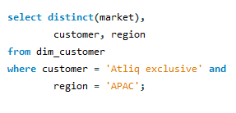
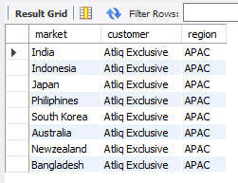
Requests 1: Provide the list of markets in which customer "Atliq Exclusive" operates its business in the APAC region.
Insights :
India is a leading market in terms of Gross Sales for Atliq Exclusive in Asia Pacific region out of 8 countries, followed by Indonesia, Japan and others.

Slide 4

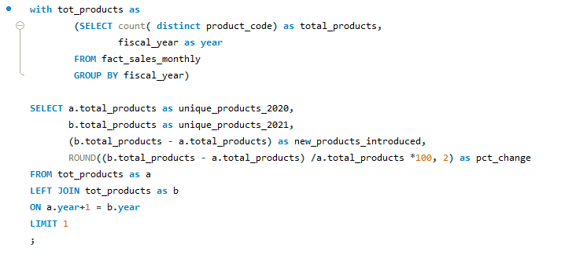
Request 2 : What is the percentage of unique product increase in 2021 vs. 2020? The final output contains these fields, unique_products_2020 unique_products_2021 percentage_chg
Insights :
The percentage of unique products increase in 21 vs 20 36.33% , in that unique products for 2021 is 334 and unique products for 2020 was 245.

Slide 5
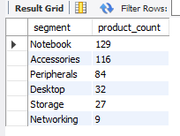
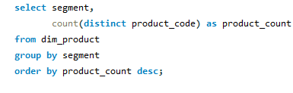
Request 3 : Provide a report with all the unique product counts for each segment and sort them in descending order of product counts. The final output contains 2 fields, segment product_count
Insights :
The unique product counts as follows notebook with products count of 129 followed by accessories with 116..

Slide 6
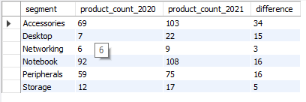
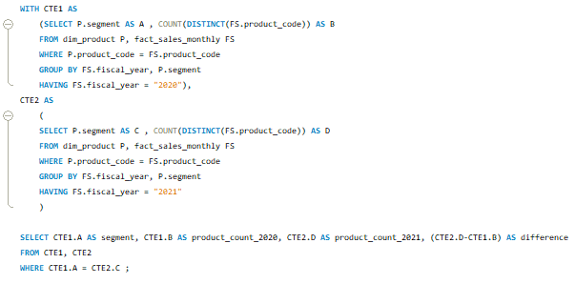
Request 4: Follow-up: Which segment had the most increase in unique products in 2021 vs 2020? The final output contains these fields, segment product_count_2020 product_count_2021 difference

Slide 7

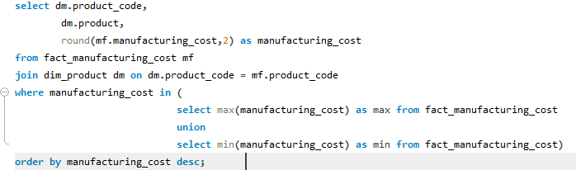
Request 5: Get the products that have the highest and lowest manufacturing costs.The final output should contain these fields, product_code product manufacturing_cost
Insights :
Product AQ Home had the highest manufacturing cost ie 240.54, where as product AQ master had the lowest manufacturing cost ie 0.89.

Slide 8
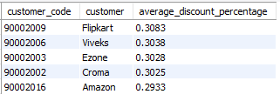
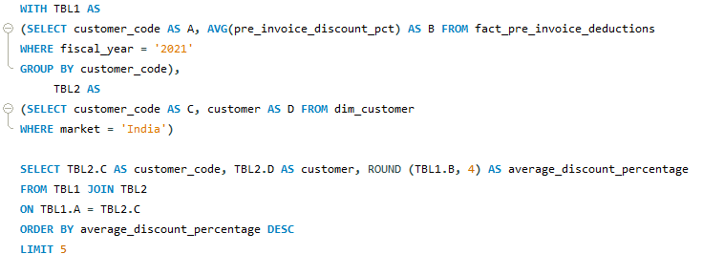
Request 6: Generate a report which contains the top 5 customers who received an average high pre_invoice_discount_pct for the fiscal year 2021 and in the indian market. The final output contains these fields, customer_code customer average_discount_percentage
Insights :
The top 5 customers as follows : Flipkart followed by vives,Ezone,croma,Amazon. Who were received a average high pre invoice discount in fy21 at Indian market

Slide 9
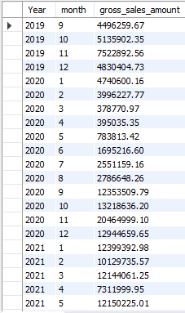
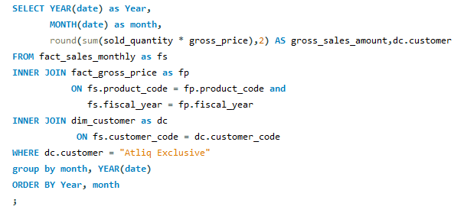
Request 7 : Get the complete report of the Gross sales amount for the customer “Atliq Exclusive” for each month This analysis helps to get an idea of low and high-performing months and take strategic decisions. The final report contains these columns: Month Year Gross sales Amount

Slide 10

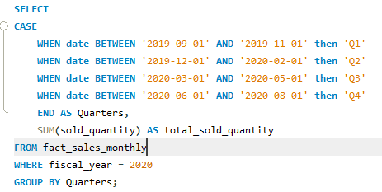
Request 8: In which quarter of 2020, got the maximum total_sold_quantity? The final output contains these fields sorted by the total_sold_quantity, Quarter total_sold_quantity.

Slide 11

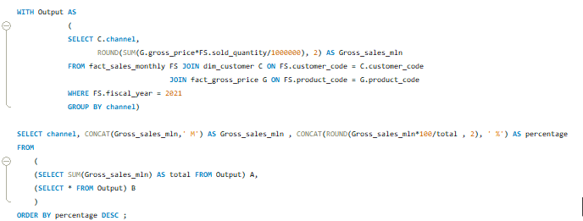
Request 9: Which channel helped to bring more gross sales in the fiscal year 2021 and the percentage of contribution? The final output contains these fields, channel gross_sales_mln percentage
Insights :
Channel retailer helped to bring more gross sales with the contribution of 73%, followed by Director and Distributer

Slide 12
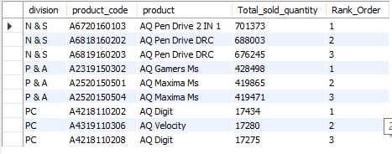
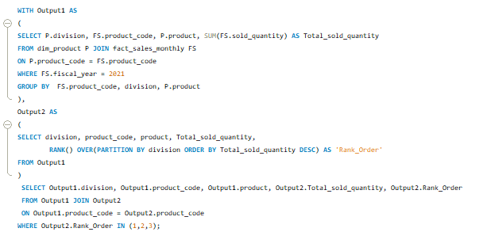
Request 10: Get the Top 3 products in each division that have a high total_sold_quantity in the fiscal_year 2021? The final output contains these fields, division product_code product total_sold_quantity rank_order

Slide 13
Thank You !

